Slide 1
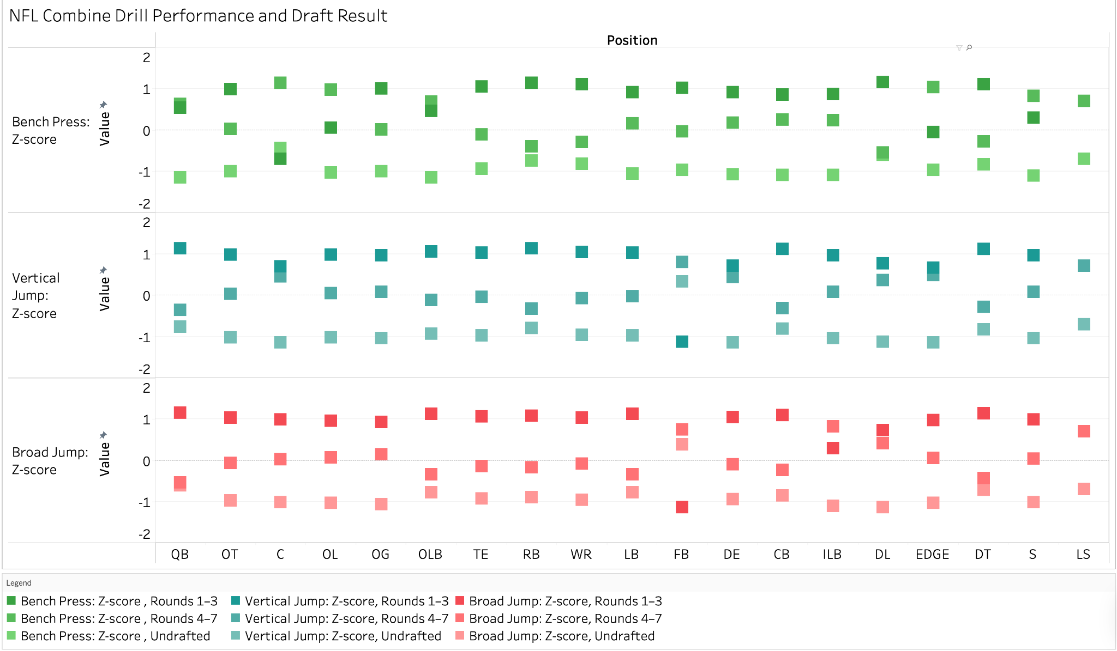
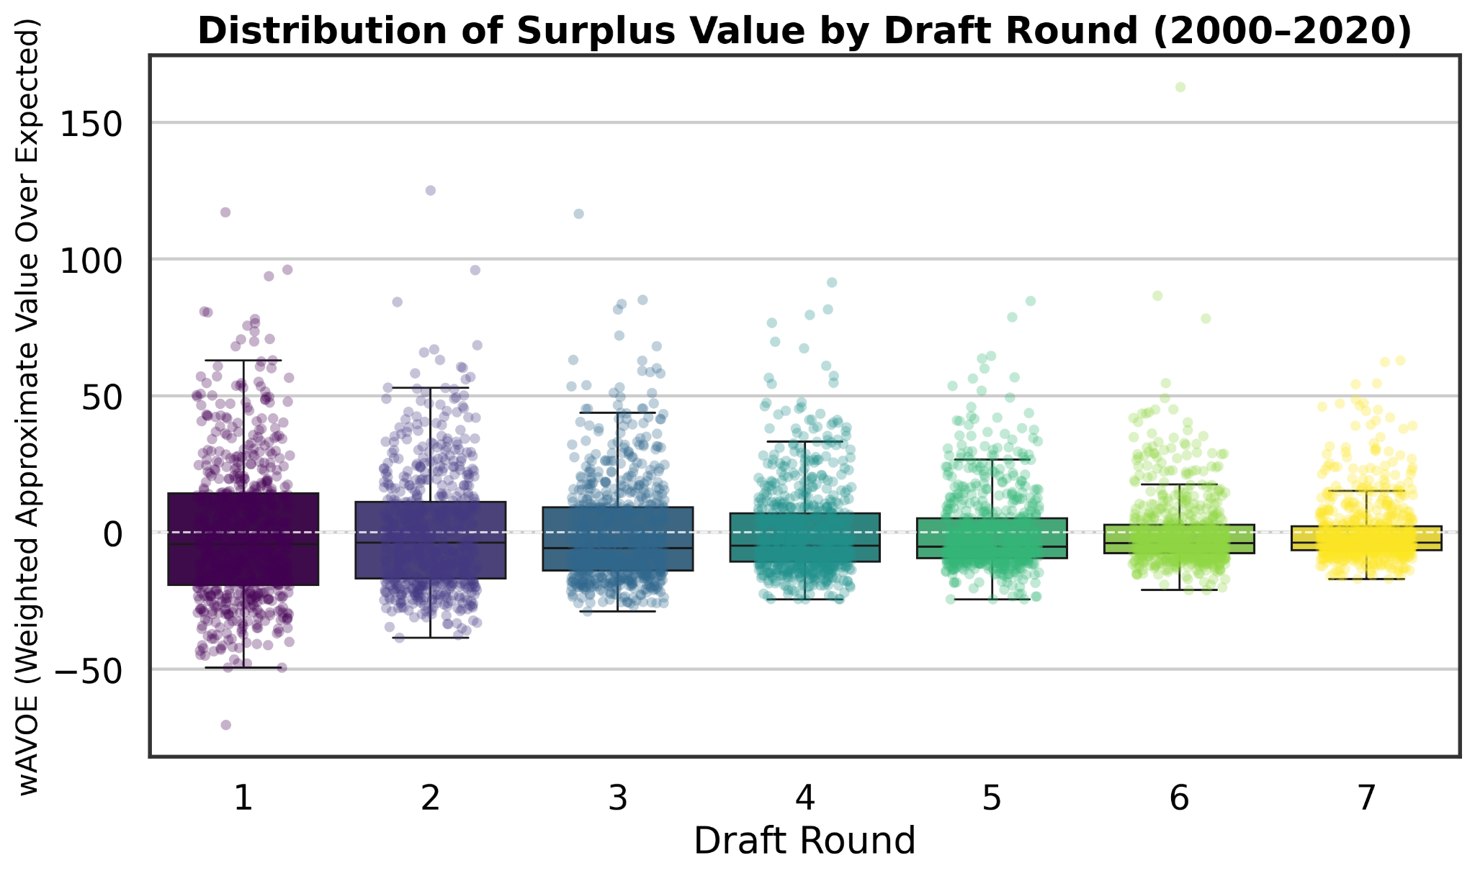
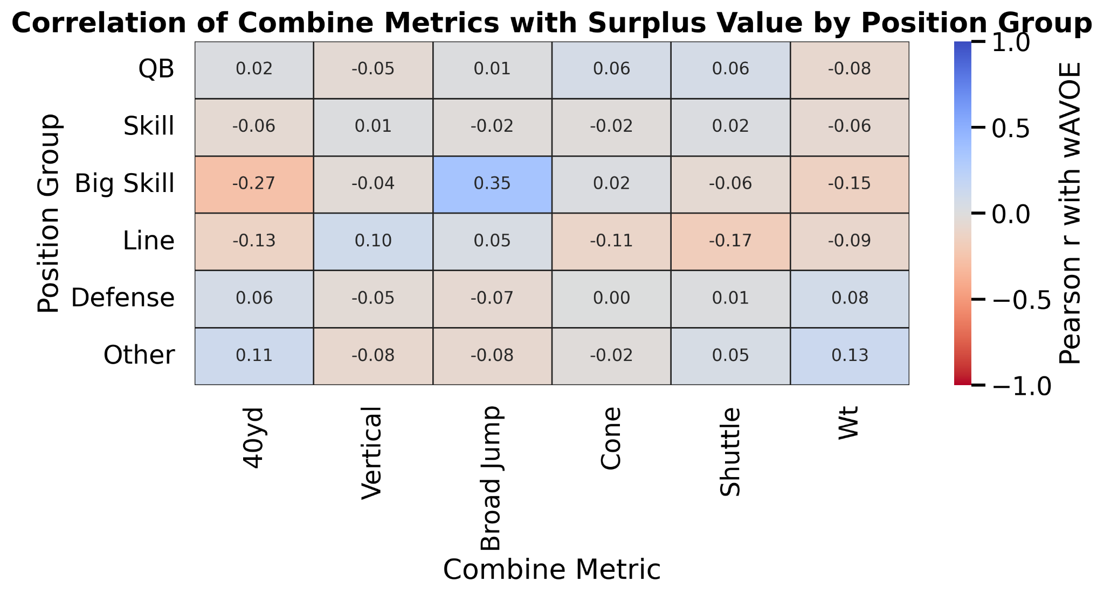
The Fantastic Four
Players’ performance of certain skills between draft rounds
The surplus value of players across draft rounds
Correlation of combine metrics and surplus value by position
waVOE (weighted approximate value over expected): measures how much a player over- or under-performed relative to the historical average for their draft slot.
Skill: RB, WR, TE
Big skill: FB, TE

